Slide 1
NYC Restaurant Inspection vs. Yelp
Minyeong Han

Slide 2
Contents
Motivation
Research Questions
Datasets
Approaches
Challenges & Limitations
Results
Conclusion
References

Slide 3
Motivation
NYC is the largest city in US: 8.6 million population & 26.7K open restaurants as of 2017.
Yelp.com is one of the most popular website at our fingertips for reviews and recommendations of best restaurants.
Given the overwhelming number of restaurants to choose, I wanted to make better decision based on reliable foundation such as compliance with the food safety regulations, not just lay opinions.
Hence, I decided to analyze the NYC restaurant inspection results and compare these with Yelp’s recommended restaurants in NYC.

Slide 4
Research Questions
The best restaurants vs. the worst restaurants
What are the restaurants that are or are not compliant with the City and State food safety regulations in NYC?
Are those restaurants getting better over time?
What does Yelp say about these restaurants in terms of star rating and reviews?
Display the best and the worst restaurants on the map
Are the Yelp’s top 10 best restaurants compliant with the City and State food safety regulations?

Slide 5
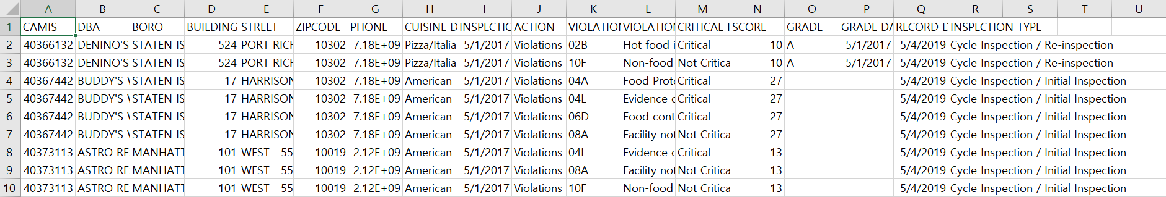
Datasets
DOHMH New York City Restaurant Inspection Results from NYC OpenData
: 383K rows x 18 columns
JSON Data obtained through Yelp Fusion API

Slide 6
Approaches
1) Extracting the most recent inspection data and choosing the 5 best and the 5 worst restaurants based on the Average scores of violation.
2) Creating the line plot of “Scores vs. inspection year” for the 5 best and the 5 worst restaurants, respectively, to see the trends.
3) Comparing with the Yelp’s star ratings and reviews.
4) Locating the best and the worst restaurants on the map.
5) Extracting Yelp’s best recommended restaurants from the inspection data set to find discrepancies if any.

Slide 7
Challenges & Limitations
1) Restaurant has different mailing addresses in the inspection dataset and Yelp dataset.
→ I used phone number to match the restaurant with the same-named restaurant, still there are some mismatched data.
2) Not every restaurant in the inspection dataset was in the Yelp dataset.
→ Unregistered restaurants in Yelp dataset, which was expected as inevitable when getting the data from two different sources.
3) The limitations of GitHub repository(100MB).
→ I deleted the records with “missing” values and truncated the records before May 2017 as three years of records suffice the purpose of analysis.
4) Fully functioning folium map does not show on the GitHub.
→ I saved the map as HTML object and embedded it here.

Slide 8
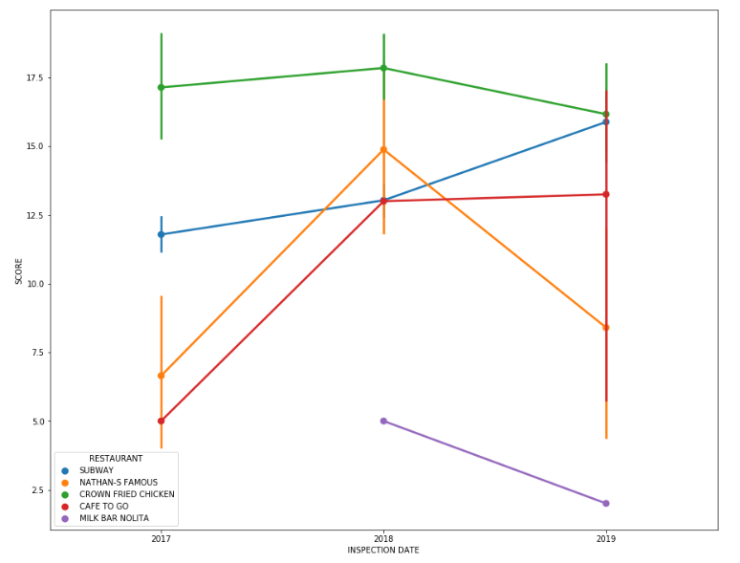
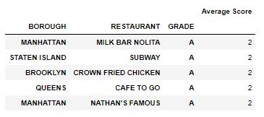
Results
The Best 5 Restaurants
Compliance trends over the years
Available on Yelp, CROWN FRIED CHICKEN has star rating of 1.5 and the review count is only 4, although the restaurant inspection result describes this restaurant as one of the top 5 in terms of compliance with the food safety regulations.

Slide 9
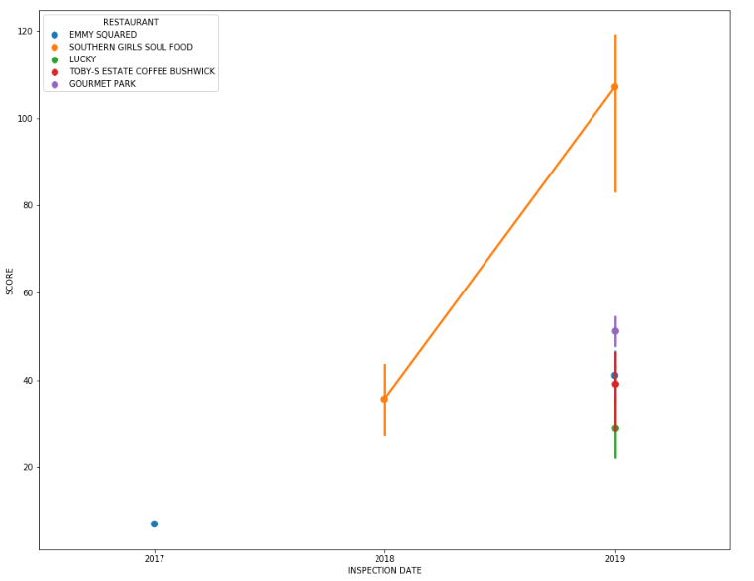
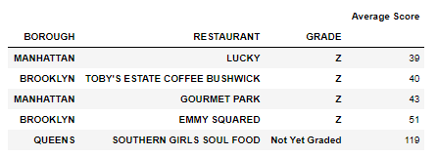
Results
The Worst 5 Restaurants
Compliance trends over the years
SOUTHERN GIRLS SOUL FOOD has star rating of 2.5 and the review count is 73 according to Yelp. This is surprising as the star rating of the best restaurant CROWN FRIED CHICKEN was 1.5 and the review count was only 4 according to Yelp.

Slide 10
Results
The best restaurant, CROWN FRIED CHICKEN reviews
Yelp API returns the three reviews. All of the reviewers gave 1 star rating. One of the review said this place was disgusting, and another review said there was a mouse trap and found a fly in cheese burger.
However, both of these reviews were created on April 12, 2018. The restaurant inspection date that I used to assess was May 2, 2019, which means the CROWN FRIED CHICKEN restaurant made an effort to improve their compliance with the food safety regulations. This also matches with the result that I drew based on the line chart above.
The worst restaurant, SOUTHERN GIRLS SOUL FOOD reviews
The reviews are not consistent. One review that gave 4 star rating said it was well worth the drive to get some quality time and good soul food. However, the other two reviews gave 1 star ratings, and one review said the reviewer was going to state nice things before going into the restaurant, and another review said if he/she could give 0 star he/she would, because of the taste of food. These reviews were all posted in 2019, and based on the line chart above, SOUTHERN GIRLS SOUL FOOD have been getting worse since 2018.
Hence, even though one of the recent reviewer gave positive reviews and 4 star ratings, I would not recommend this restaurant, as the reviewer did not mention food safety, and the restaurant inspection result showed this restaurant received the highest violation score in May 2, 2019.

Slide 11
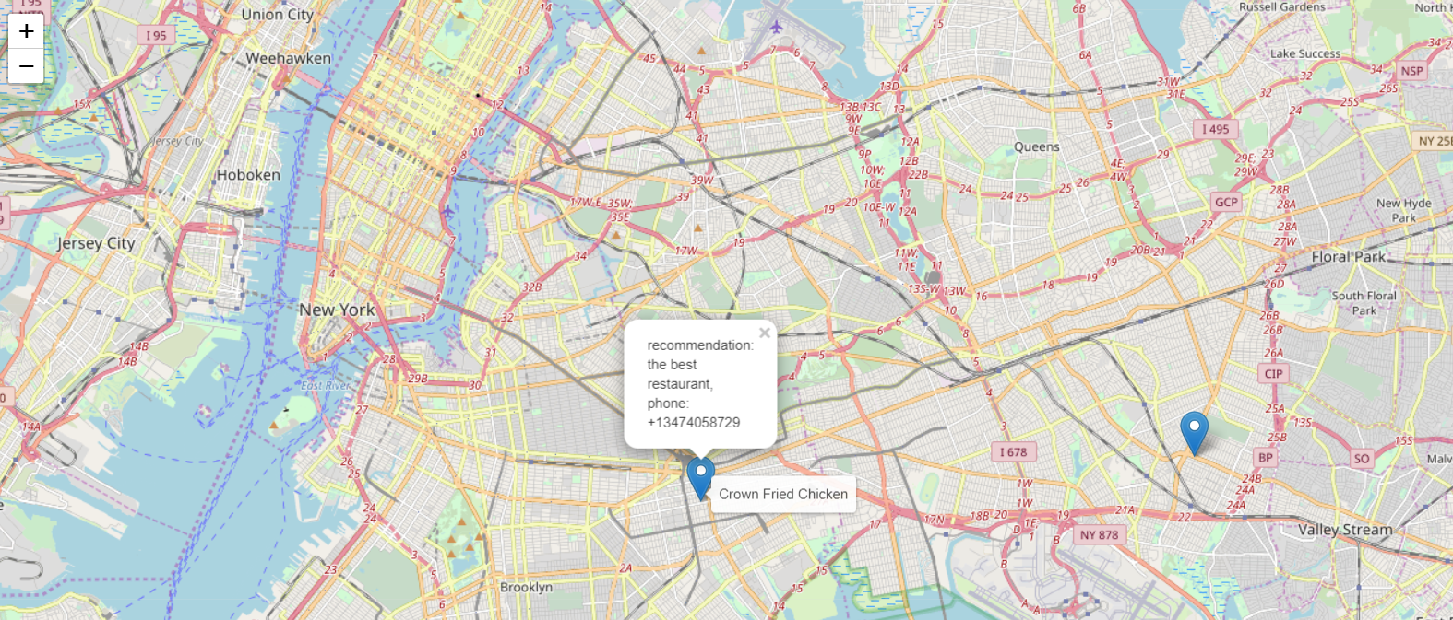
the best & the worst restaurants

Slide 12
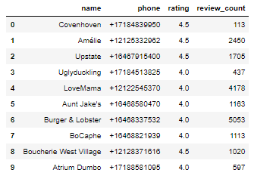
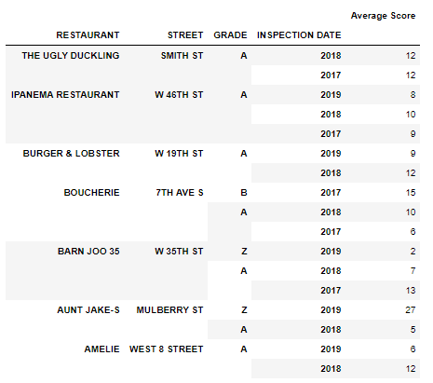
Results
Yelp’s best restaurants
Inspection results
The three restaurants do not have matched phone number in the inspection result dataset.
Only three restaurants received A GRADE in 2019, two were not inspected in 2019, and two restaurants received pending grade in 2019.
This result confirms that Yelp's best restaurants are not necessarily compliant with the City and State food safety regulations.

Slide 13
Conclusion
Restaurants that we see as the best restaurants on Yelp.com do not necessarily have the best inspection results.
Yelp's star ratings and reviews are frequently used to decide where to eat outside home in our everyday life, however, by doing this project, I learned that the Yelp's star ratings and reviews mentioning great taste, service or convenient distance do not guarantee the safety of food they serve and the respective restaurant's compliance with the City and State food safety regulations.
I suggest that we should refer to the Health Department's restaurant inspection result once we pick a restaurant based on the Yelp as a starting point to ensure we are having food that is safe to eat, and prepared in safe environments.

Slide 14
References
DOHMH New York City Restaurant Inspection Results
https://data.cityofnewyork.us/Health/DOHMH-New-York-City-Restaurant-Inspection-Results/43nn-pn8j
How we score and grade
https://www1.nyc.gov/assets/doh/downloads/pdf/rii/how-we-score-grade.pdf
Get started with the Yelp Fusion API
https://www.yelp.com/developers/documentation/v3/get_started
World Popultion Review
http://worldpopulationreview.com/us-cities/new-york-city-population/
Burdens abound, but NYC restaurants' numbers are growing
https://www.crainsnewyork.com/article/20180412/BLOGS01/180419940/burdens-abound-but-nyc-restaurants-numbers-are-growing
Don’t Eat Out as Often (188/365)
https://www.thesimpledollar.com/dont-eat-out-as-often-188365/

